Slide 1


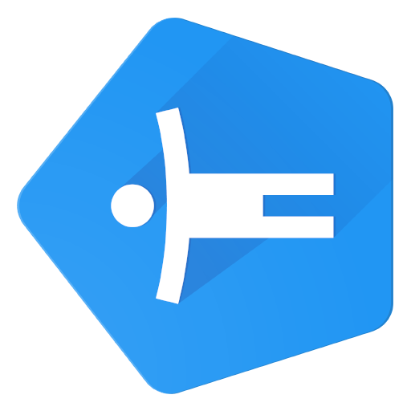

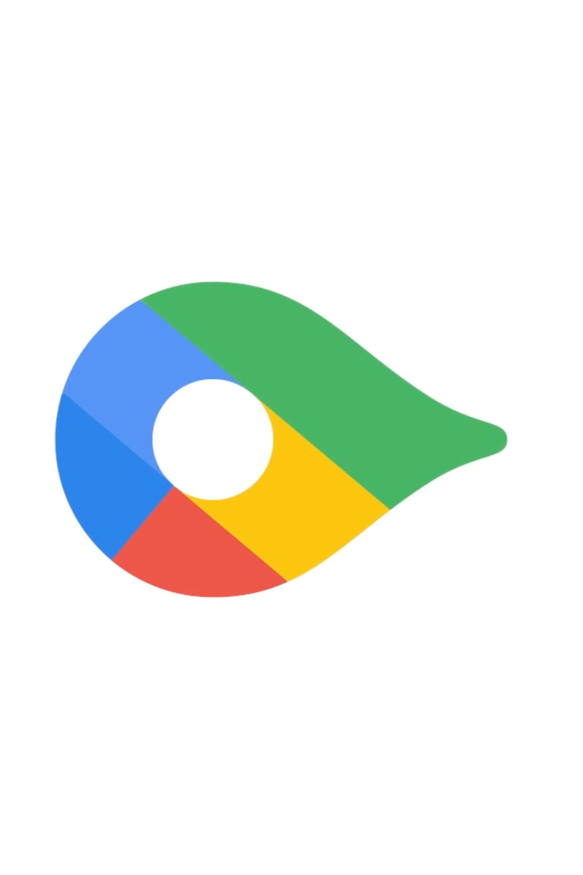


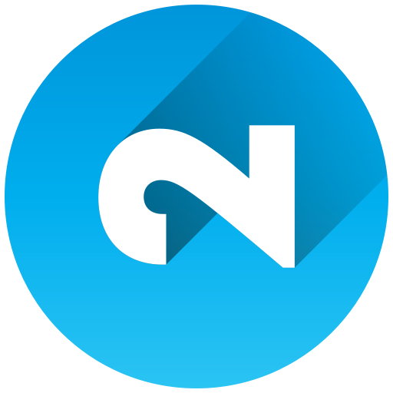
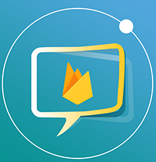
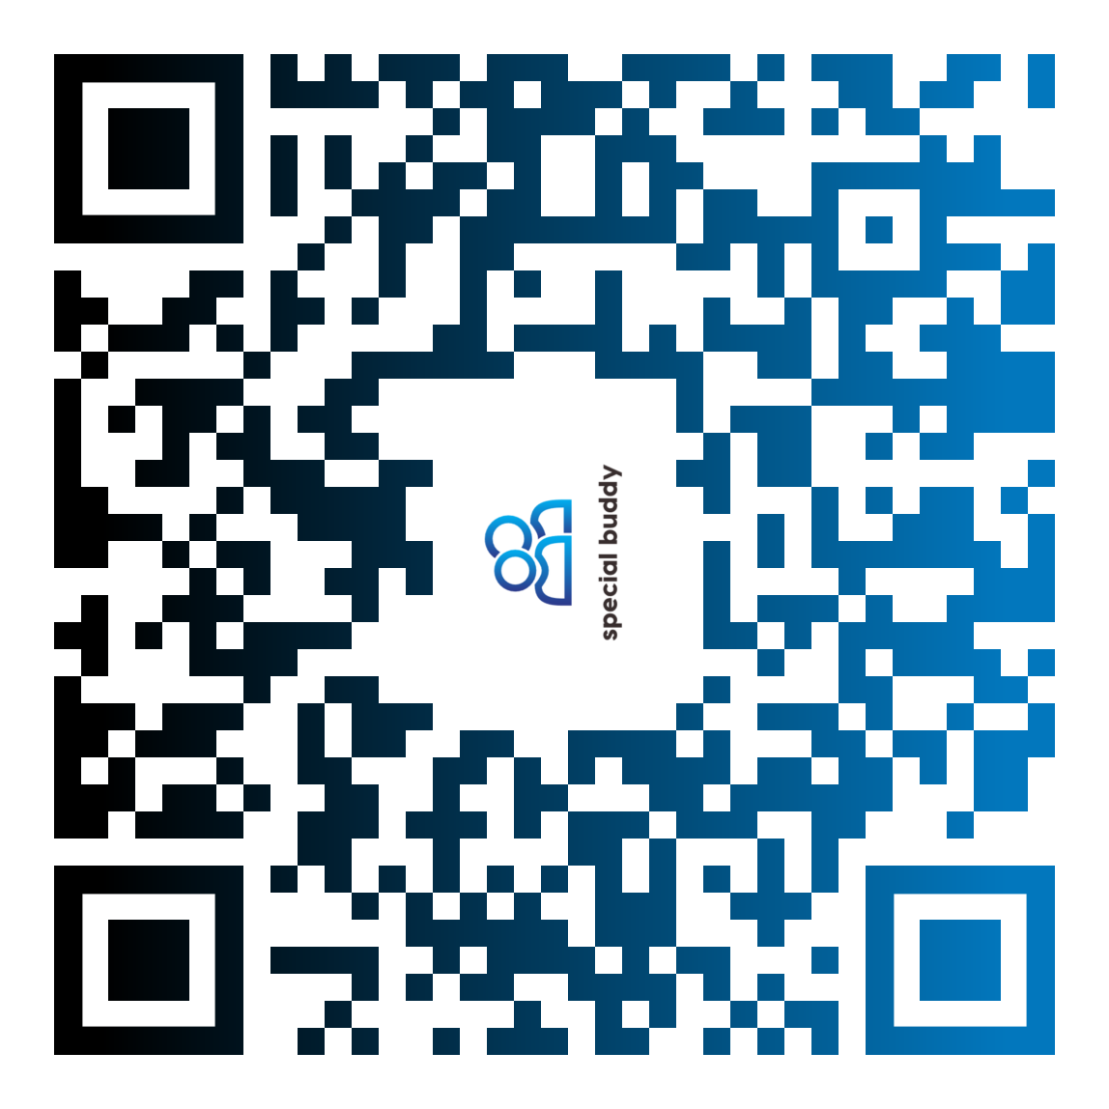
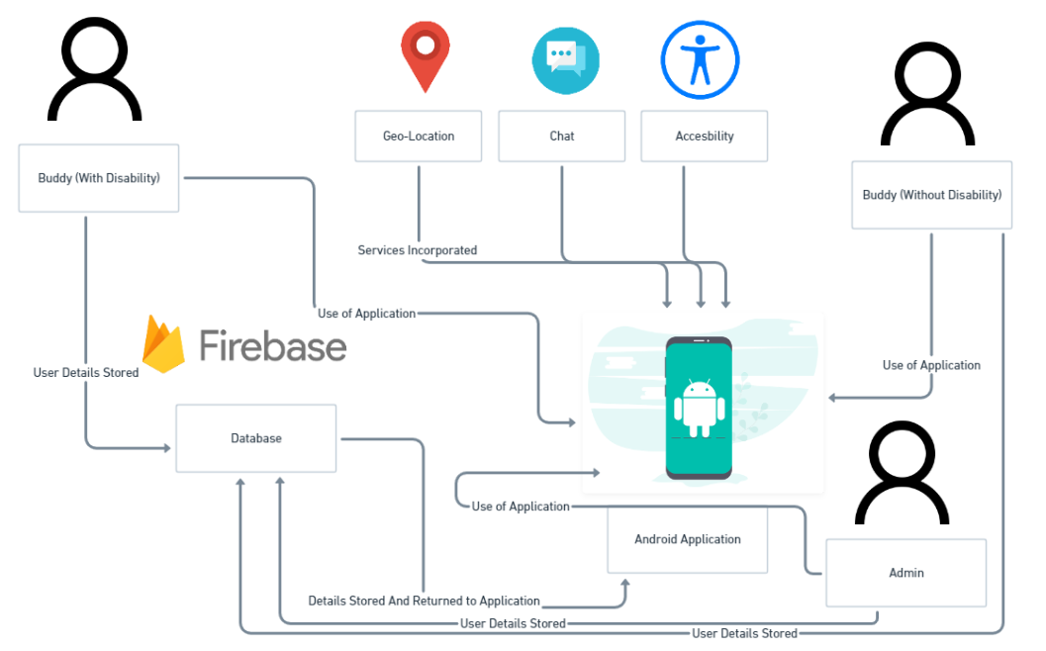





Carry out all the functional requirements as stated in the final year project dissertation.
Find more background and information on the subject of social; loneliness among people with disabilities
Research tools and technologies that would be used in developing the project.
Learn and gain experience on new technologies that have not previously been used.
Objectives
Conclusion
• Android Studio for the IDE (Integrated Development Environment) to prototype and code my application.
• Google Firebase Console to support my database.
• Google API to support the Google Maps implementation of my application.
Technologies Used
• After undertaking this final year project, I can definitely say that I now fully know how undertaking an investigation is like and how it is conducted.
• Throughout the implementation of my application, I did encounter a number of errors with certain components. I managed to fix most, if not all, the errors.
• If I were to do this project again, I would change some of my objectives. Instead of keeping too many requirements to implement within a specific time range.
Aim
The aim is to create an android mobile based application that would help people with disabilities to overcome their solitude and to interact with peers or buddies without much difficulty using a social online platform.
An android mobile application to assist people with various disabilities and to connect them to an online buddy system
Fyaz Qadir Ahmed Ikram | K00237093 | Technological University of Shannon : Midlands Midwest | Supervisor: Pamela O’Brien
Internet for researching both tools and technologies and also background research for literature review
Library Resources for technology and literature review research
Interviews to gain further insight and taught into the subject of study
Group of 5 people to test the final product and give feedbacks and improvements on it.
The author has looked at the problem of social isolation and loneliness with people with intellectual and physical disabilities and decided to create a mobile application to have a buddy system wherein two parties (Buddies and people with disabilities) could interact
and socialize with one another.
The reason for this Project’s development was to assist people with various disabilities (physical and mental) and help them socially interact with people without any disabilities using a real time buddy mobile application.
Use an Integrated Development Environment
Code the Application in Java
Use other technologies to incorporate into the project
Methods
Introduction
Findings

